Slide 1
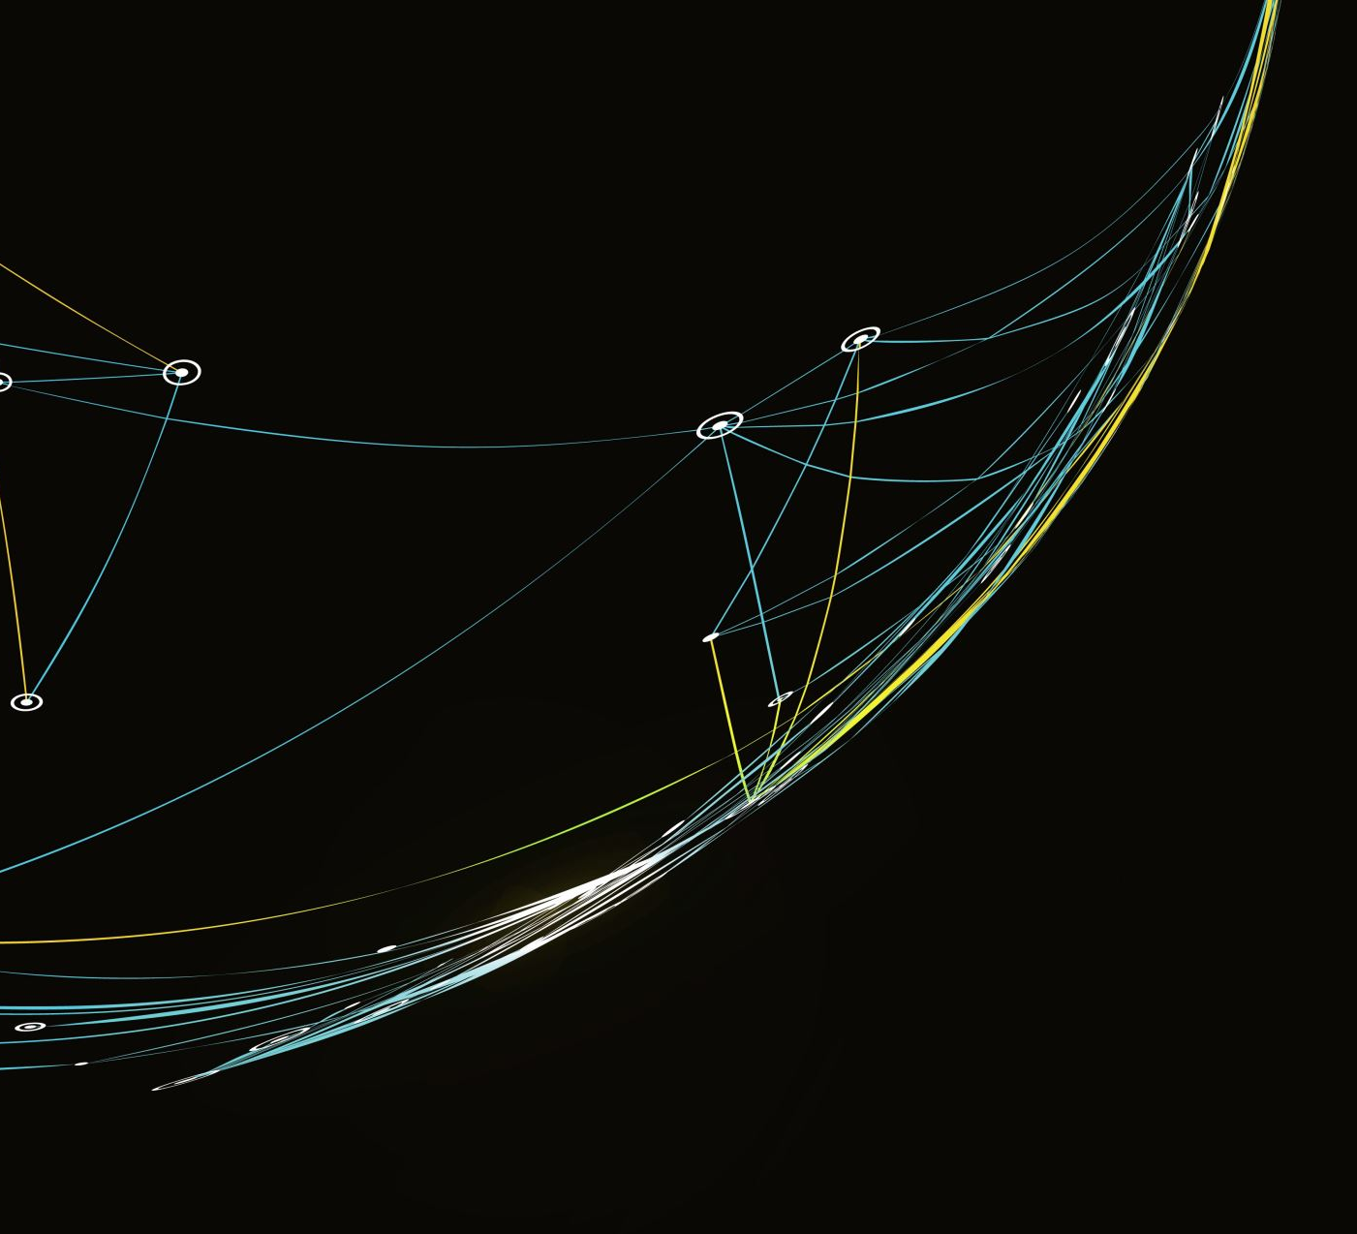
Time-Series Foundation Models (TSFM)
In Finance

Slide 2
Agenda
Summary
Why is time-series forecasting important? (slide3)
Why is there a need for another way of doing time-series forecasting? (slide4)
What is the solution to the previous question? – Answer: (slide 4)
What are TSFMs? (slide 5)
Which are the best / most popular TSFMs? (slides 6 and 7)
HOW are we going to figure out if they are useful in Finance? (slide 8)
How do we evaluate time-series forecasting performance? (slide 9)
What do we compare TSFMs with? (slide 10)
How do we set up the experiment? (slide 11)
What have we done so far? (slides 12 and 13)
What should we do in the future? (slides 14 and 15)
What does the future schedule look like? (slides 16 and 17)
Notes:
AGENDA – TABLE OF CONTENTS: summarizes what is on which slide

Slide 3

Do TSFMs outperform traditional time-series prediction models in the field of finance?
comprehensive study on state-of-the-art Tsfm performance on financial datasets
Notes:
The topic of my dissertation

Slide 4
Summary
What is the solution? Answer: TSFMs!
TSFMs are already pre-trained on large amounts of diverse time-series data thus using them reduces the need for proprietary data collection, cleaning, storage, etc…
They are rather simple and ready to use.
They are flexible and apt for use on many different types / instances of time-series data without the need for retraining (however the option for fine-tuning still exists).
They are proven effective on general datasets. The aim of this research is to establish whether they are effective in FINANCE.
How do we find out whether TSFMs are effective?
Why need for changing time-series forecasting?
Models’ performance needs to be measured
This is done using standard regression metrics
We need to make sure that the evaluation is statistically significant
This is done by employing Time Series Cross Validation (TSCV)
We need to compare the TSFM against a benchmark
Benchmark are the traditional time-series prediction models
Time-series forecasting is hard. Building ML pipelines for time-series forecasting models requires specialized expert knowledge.
Furthermore, those pipelines can be 100s of lines of code. Finding bugs or tuning such a code can therefore be quite complicated
Finally: acquiring, cleaning and storing the training data, and employing staff to maintain the ML pipeline can be rather expensive.
Notes:
Summary of the context of my dissertation

Slide 5
Time series forecasting
Financial planning and budgeting
Risk management
Strategic decision-making
Enables decision-makers to prepare for the future

Slide 6

Time-series foundation models
Standard Time-serieS, transformer-based, self-supervised, generative
Notes:
Transition slide

Slide 7
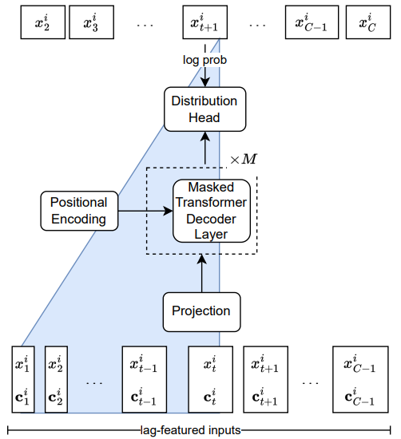
Lag llama
ARCHITECTURE
2,449,299 parameters
Trained on 27 time-series datasets (352m tokens / 7,965 univariate time-series)
Fine tuning capabilities
Univariate time-series forecasting without exogenous variables
Notes:
What is Lag llama?

Slide 8
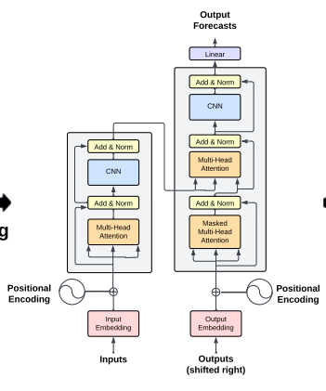


Time gpt
ARCHITECTURE
??? parameters
Trained on 100b data-points
Fine tuning capabilities
Anomaly detection
Multivariate time-series forecasting with exogenous variables
Notes:
What is TimeGPT?

Slide 9

Methodology
Evaluation, Benchmark and experiment parameters
Notes:
Transition slide

Slide 10
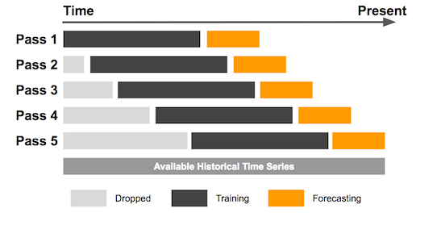
evaluation
RMSE is a general loss metric.
R2 is handy because (in theory) it is between 0 and 1, thus giving an intuitive interpretation of how well the predictions fit the actual data.
MAPE tells us what percentage of the actual values were the predictions off.
MDA doesn’t say whether the predictions were good or bad, but rather it measures how good the DIRECTION of predictions are.
To ensure statistical significance, we will run the K-fold Time series Cross Validation on every time-series. This ensures that that the result we get is not a product of coincidence, rather it shows performance of the models across different time periods.
K and the size of the training set are parameters of the experiment.
RMSE
R2
MAPE
MDA
Notes:
How will we evaluate the models?

Slide 11
Benchmark
Autoregressor
autoARIMA
Prophet
Linear regression of the future value on only one previous value
Simple but proved quite effective for stock market price predictions
ARIMA model with automatic hyperparameter (P, I, Q) selection
AR (Autoregressive) component of the model approximates the linear relationship between the previous P datapoints and the future prediction
I (Integrated) component tests the stationarity of the data and transforms the data to stationary form
MA (Moving Average) component approximates the linear relationship between the prediction and Q-period moving average of the time-series
Generalized Additive model (GAM)
Works well with non-linear trends, seasonality and holiday effects
Robust to missing data and shifts in the trends
Handles the outliers well
Widely used
Built by Facebook (Meta)
Notes:
What are we going to compare the models with? Change the order of models / put autoregressor first.

Slide 12
Experiment parameters
Stock prices
Stock returns
Volatility
Trading volumes
Interest rates
Exchange rates
Commodity prices
Type of data
Frequency of data
Context length and training size
Exogenous variables
Periods of different Economic conditions
Forecast horizon (n periods)
Minutely
Hourly
Daily
Monthly
Quarterly
L = 32, 64, 128, …, 1024
The Experiment is to be run in every possible configuration according to each possible combination of the outlined parameters
No
Yes (Which?)
Stable
Inflation
One
More than one
Notes:
What are we going to experiment with? – resize the boxes

Slide 13

Current progress
Notes:
Transition slide

Slide 14
Minimum Viable Prototype
Implemented the Lag-Llama, autoregressor and autoARIMA models in abstracted way
Ability to get model predictions with a single line of code
Rudimentary data capabilities
Ability to get desired stock price and stock return data of desired frequency with a single line of code
TSCV functionality
Ability to run TSCV and get results on a desired time-series with custom n_folds and prediction_horizon
Results visualization
Results of the TSCV visualized in an interactive manner

Slide 15
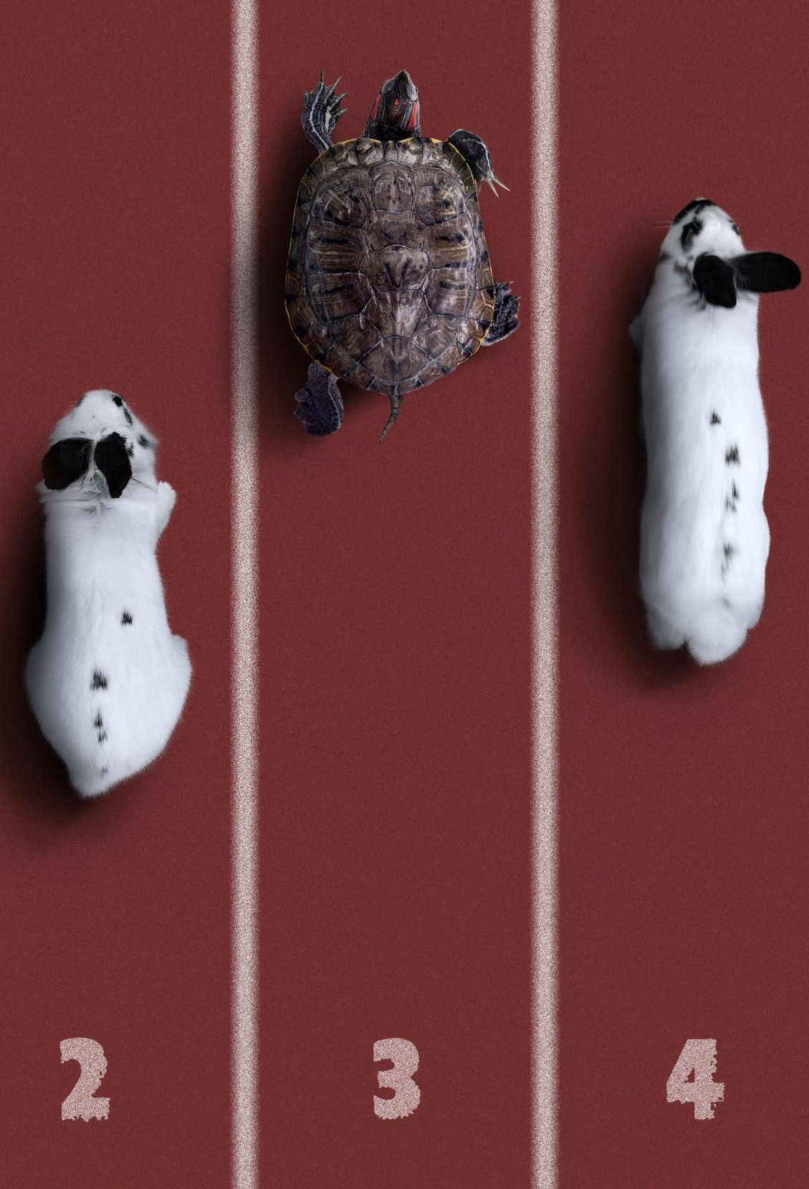
Implemented and abstracted the Lag-Llama, autoARIMA and autoRegressor models
get_(MODEL_NAME)_predictions(data, prediction_horizon)
Standardized all the models is a way that they take data of the same format as input
Notes:
„minimum viable prototype“ – fit into 1 slide

Slide 16

Implemented rudimentary data sourcing capabilities which enables loading, writing and reading of the different types of data
data_loader
data_writer
data_reader

Slide 17

Implemented the TSCV functionality which returns the results of the TSCV over the given time-series. Results come in form of dataframes containing the information on all the evaluation metrics (mentioned before) as well as the actual predictions across all folds of the Cross Validation
get_tscv_results(data, prediction_horizon, context_length, n_folds)

Slide 18

Created the visualization code
Summary statistic graph of all metrics (showing their mean, median, and standard deviation)
Interactive version with ability to choose which models and which metrics you want to be displayed on the graph
Interactive visualization of all models’ prediction where you can manually choose which models’ prediction you want to see and compare with the actual values – for any fold of the Cross Validation

Slide 19

Preliminary results
Notes:
Transition slide

Slide 20
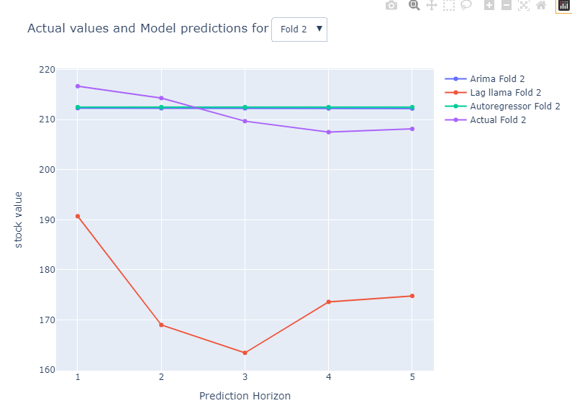
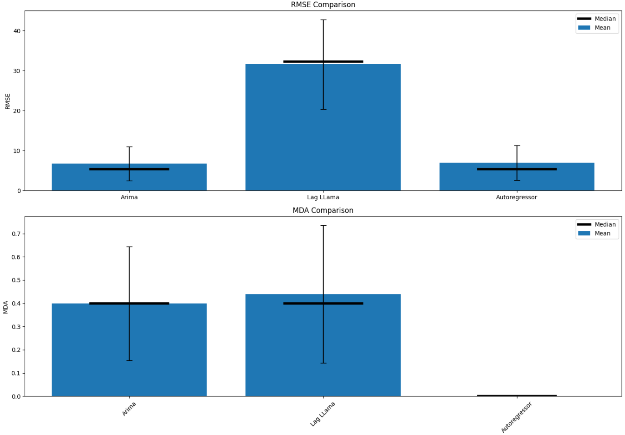

Slide 21
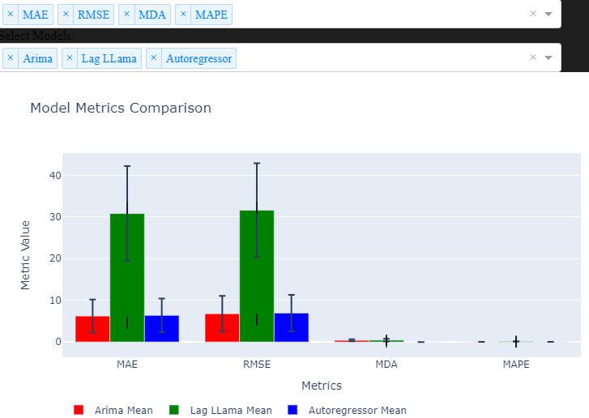

Slide 22

Next steps
Notes:
Transition slide

Slide 23
TimeGPT
XGBoost
DeepAR
Prophet
Implement more models
Fine-tune TSFMs
Gather more types of data
Run the experiment on different configurations
Record and summarize results
Exchange rates
Interest rates
Volatility
Trading volumes
Notes:
What are the next steps? -

Slide 24

Thank you

